Slide 1


<Name>
<Date>

Slide 2

Outline
Executive Summary
Introduction
Methodology
Results
Conclusion
Appendix

Slide 3
Executive Summary
Summary of methodology
Launch Data is gathered from the SpaceX REST API including web scrapping from a Wiki page and data wrangling
Exploratory data analysis (EDA) using visualization and SQL including interactive visual analytics (Folium and Plotly Dash)
Predictive analysis using ML classification models including model building, tuning and performance evaluation of the classification models
Summary of all results
A Decision Tree classifier has the highest accuracy of the tested models (88.9 accuracy on the test data

Slide 4
Introduction
In this capstone project for the Applied Data Science Capstone module, we will predict if the Falcon 9 first stage will land successfully. This has a direct application on determining the cost of a launch by knowing if the first stage will land
All the process is detailed from collecting the data, wrangling, analysing and machine learning building to final conclusions

Slide 5

Section 1

Slide 6
Methodology
Executive Summary
Data collection methodology:
SpaceX Launch Data is gathered from the SpaceX REST API
Web scrapping from a Wiki page is performed to collect Falcon 9 historical launch records
Perform data wrangling
Describe how data was processed
Perform exploratory data analysis (EDA) using visualization and SQL
Perform interactive visual analytics using Folium and Plotly Dash
Perform predictive analysis using classification models
How to build, tune, evaluate classification models

Slide 7
Data Collection
GitHub Link here
SpaceX Launch Data is gathered from the SpaceX REST API
Data about launches: rocket used, payload delivered, launch specifications, landing specifications, and landing outcome.
Wrangling Data using an API to convert data (json) into a pandas Dataframe
Data = pd.json_normalize(response.json())
Web scraping is performed to obtain Falcon 9 Launch data
Python BeautifulSoup package is used for web scraping HTML tables (wiki pages) with Falcon 9 launch records.

Slide 8
Data Collection – SpaceX API
GitHub Link here
Helper functions are used to extract API information using identification numbers
Data is requested from the URL (endpoint):
https://api.spacexdata.com/v4/launches/past
Data is requested and parsed using the GET request (response = requests.get(url))
Response content is decoded as Json and turned into padas DF (.json_normalize())
Only Falcon 9 launches data is kept
Data wrangling using an API is also used to target targeting another endpoint to gather specific data for each ID number
the mean of PayloadMass is used to replace np.nan values in the data (replace() function)
rocket
Booster name
payload
Payload mass
Orbit name
launchpad
Launch site name
Longitude
Latitude
cores
Landing outcome
Number of flights
Gridfins used (y/n)
Reused core (y/n)
Legs used (y/n)
Landing pad used
Core block (number)
Cores reused (num times)
Core serial

Slide 9
Data Collection - Scraping
GitHub Link here
URL (Wikipedia)
Web scrapping from a Wiki page is performed using Python’s BeautifulSoup
to collect Falcon 9 historical launch records
Table is parsed and converted into a pandas DF
https://en.wikipedia.org/w/index.php?title=List_of_Falcon_9_and_Falcon_Heavy_launches&oldid=1027686922
Request.get(url)
DataFrame
Flight No
Launch site
Payload
Payload mass
Orbit
Customer
Launch outcome
Version Booster
Booster landing
Date
Time
BeautifulSoup(html_data)
HTM Table

Slide 10
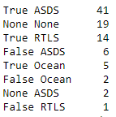
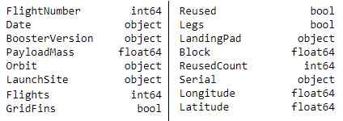
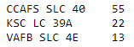
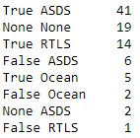
Data Wrangling (EDA)
GitHub Link here
There are 17 different attributes in the Data Set
Numerical and categorical columns
Missing values are identified for each attribute
There are 3 types of launches for each site with different counts and 11 types of orbits
The Outcome indicates if the first stage successfully landed. There are 8 of them
The Landing Outcomes are converted to Classes
0: bad outcome, the booster did not land.
1: good outcome, the booster did land.
This is the classification variable that represents the outcome of each launch (66.6% of success rate)

Slide 11
EDA with Data Visualization
GitHub Link here
Following charts were plotted
FlightNumber vs. PayloadMass
FlightNumber vs. LauchSite
Payload mass vs. LauchSite
Success rate vs. Orbit type
FlightNumber vs. Orbit type
Payload mass vs. Orbit type
Launch success yearly trend
These are done to evaluate relationships between variables and with between variables and the outcome

Slide 12
EDA with SQL
GitHub Link here
Following information was retrieved using SQL queries
Unique launch sites names in the space mission
5 records where lauch sites name begin with the string ‘CCA’
Total payload mass carried by boosters NASA (CRS)
Average payload mass carried by booster F9 v1.1
Date when the first successful landing outcome in ground pad was achieved
Boosters which have success in drone ship and have payload mass greater than 4000 but less than 6000
Total number of successful and failure mission outcomes
Booster versions which have carried the maximum payload mass

Slide 13
Build an Interactive Map with Folium
GitHub Link here
For each Launch site, a circle marker is added into the map (folium.Circle and folium.Marker)
All launch sites are very close in proximity to the coast and relatively close to the Equator line (CCAFS LC-40, CCAFS SLC-40 and KSC LC-39A being the closest in Florida
Markers are classified for all launch records:
Successful launch (class=1), a green marker is used; failed launch (class=0), a red marker is used
For each launch result, a folium.Marker to marker_cluster is added
Marker clusters are used to simplify a map containing many markers with the same coordinates
Proximities of launch sites are explored and analyzed:
MousePosition is added on the map to get coordinates for a mouse over a point on the map
PolyLine are added between a launch site to the selected points of interests (city, railway, highway)
Markers with distances are also added
Launch sites in Florida are close to highways, railways and coastlines but further apart from a major city (70 km from Orlando)

Slide 14
Build a Dashboard with Plotly Dash
GitHub Link here
A dashboard completed so it can be used to analyze SpaceX launch data
It contains input components which allow to interact with a pie chart and a scatter point chart
Launch Site Drop-down Input Component
To select one specific site and check its detailed success rate (class=0 vs. class=1)
A callback function to render success-pie-chart based on selected site dropdown
To get the selected launch site from site-dropdown and render a pie chart visualizing launch success count
Add a Range Slider to Select Payload
To easily select different payload range and see if some visual patterns can be identified
Add a callback function to render the success-payload-scatter-chart scatter plot
To observe how payload may be correlated with mission outcomes for selected site(s)

Slide 15
Predictive Analysis (Classification)
GitHub Link here
For the Predictive Analysis, a ML (machine learning) pipeline is built
The goal is to predict if the first stage of the Falcon 9 lands successfully
Scikit-learn Python library is used to pre-process the data
The model is trained and a Grid Search is performed
Confusion Matrix
Different ML
algorithms are tested
Logistic regression (LR)
Support Vector Machine (SVM)
Decision Tree Classifier (DT)
K-nearest Neighbours (K-NN)
Standarize data
Datasets splits
Data Pre-processing
With these parameters we determine the model with the best accuracy using the test set
Train
Test
We find the best hyperparameters

Slide 16
Results
Exploratory data analysis results
Interactive analytics demo in screenshots
Predictive analysis results

Slide 17

Section 2

Slide 18
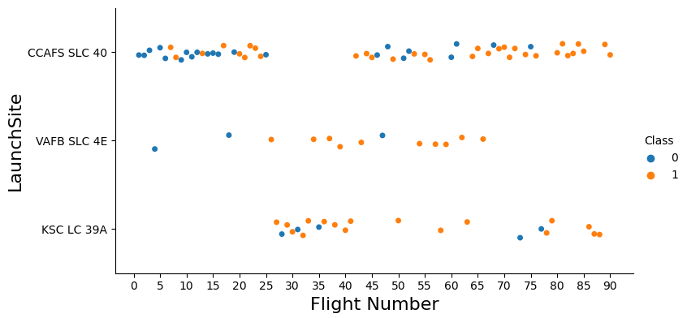
Flight Number vs. Launch Site
For the three launch sites, as Flight Number increases, the success rate also increases
VAFB-SLC-4 has the highest success rate with the smallest number of flights

Slide 19
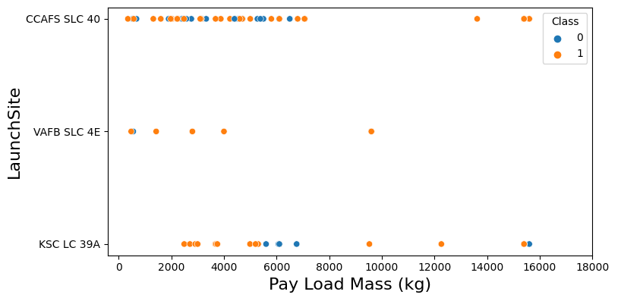
Payload vs. Launch Site
For the VAFB-SLC launchsite there are no rockets launched for heavy payload mass ( greater than 10000 Kg)
96% and 86% of launches are below the 10,000 Kg mark for CCAFS-SLC and VAFB-SLC respectively

Slide 20
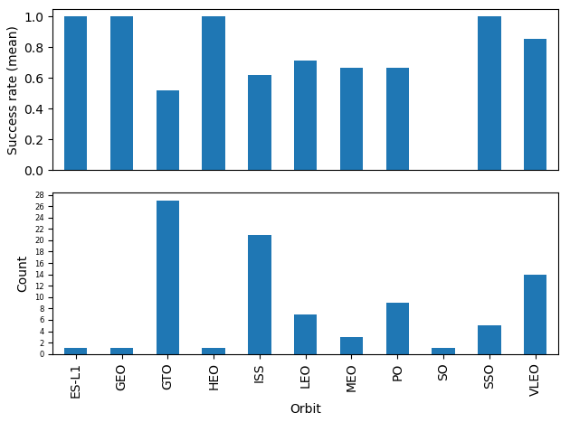
Success Rate vs. Orbit Type
SSO has 100% success rate, with 5 launches (count)
Three orbits (ES-L1, GEO, HEO) have a 100% success rate, but with only one launch
Orbits with highest number of launches are GTO and ISS (27 and 21), with 52% and 62% success rates, respectively

Slide 21
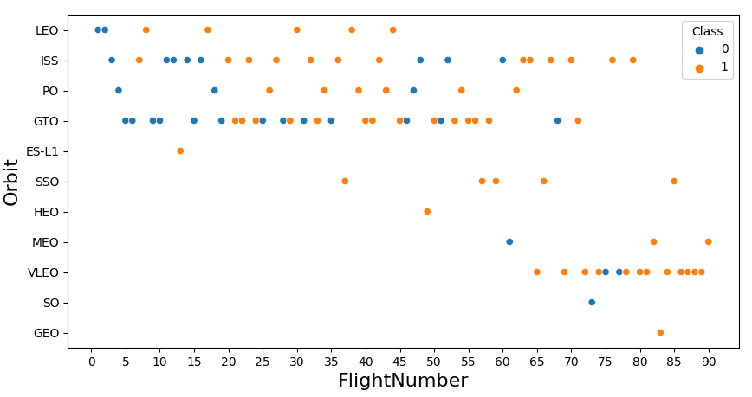
Flight Number vs. Orbit Type
For LEO orbit the success appears related to the number of flights;
No clear relationship between flight number and other orbits

Slide 22
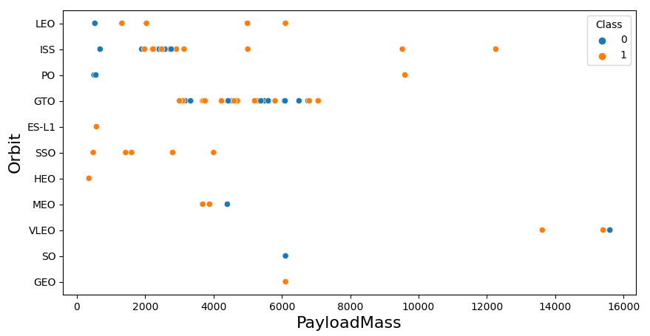
Payload vs. Orbit Type
LEO and ISS orbits show increasing number of success landing with heavier payloads

Slide 23
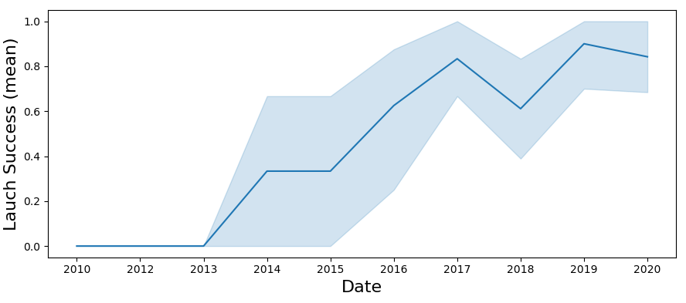
Launch Success Yearly Trend
The success rate has been increasing since 2013
Except between 2017 and 2018 and between 2019 and 2020

Slide 24
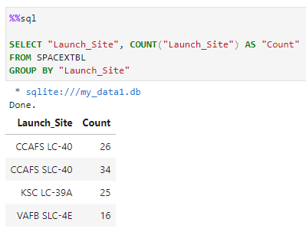
All Launch Site Names
There are 4 different Launch Sites
CCAFS SLC-40 has the higher count, VAFB the lowest

Slide 25
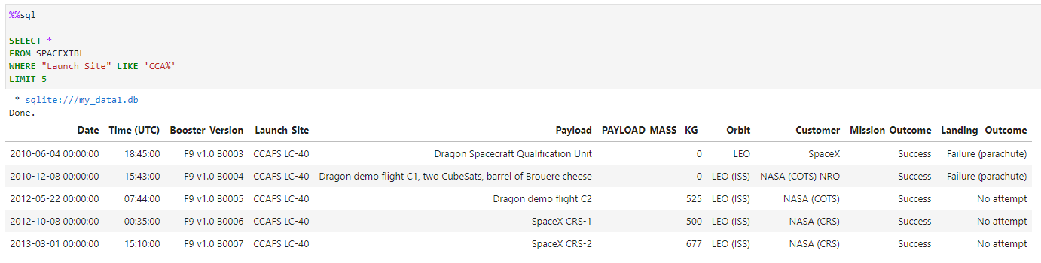
Launch Site Names Begin with 'CCA'
5 records where Launch sites begin with the string “CCA”

Slide 26
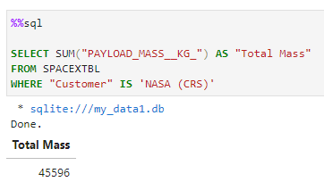
Total Payload Mass
The total Payload Mass carried by boosters launched by NASA (CRS) is 45,596 Kg

Slide 27
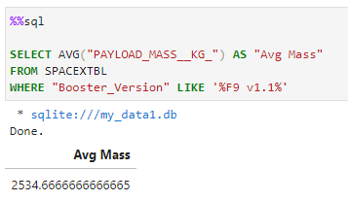
Average Payload Mass by F9 v1.1
Average Payload Mass carried by booster version F9 v1.1 is 2,534.67 Kg

Slide 28
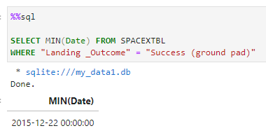
First Successful Ground Landing Date
The first successful landing outcome in ground pad was achieved in 22/12/2015

Slide 29
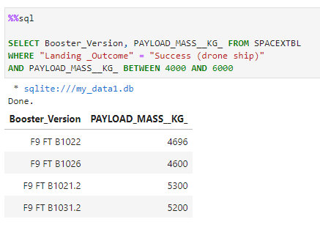
Successful Drone Ship Landing with Payload between 4000 and 6000
These are the names of the boosters which have success in drone ship and have payload mass between 4,000 and 5,000 Kg

Slide 30
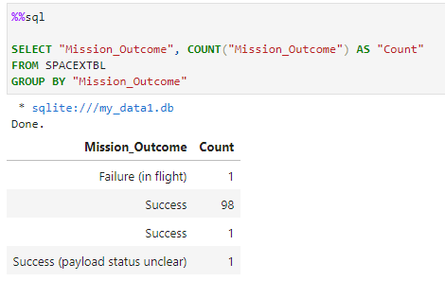
Total Number of Successful and Failure Mission Outcomes
This is the total number of successful and failure mission outcomes
100 success (3 types) and 1 failure

Slide 31
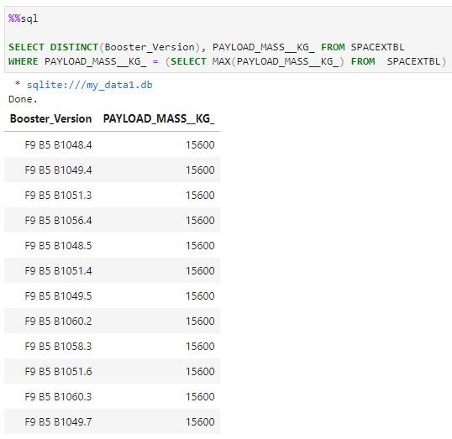
Boosters Carried Maximum Payload
These are the booster versions which have carried the maximum payload mass (15,600 Kg)

Slide 32
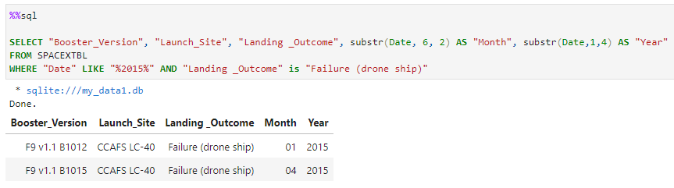
2015 Launch Records
These are the records for failure landing outcomes in drone ship versions for 2015
Displaying month and year

Slide 33
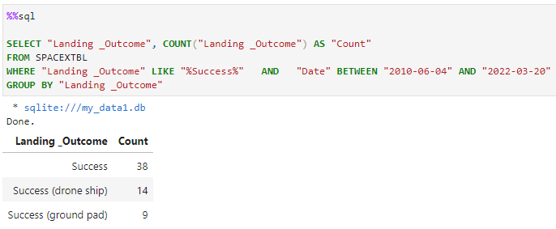
Rank Landing Outcomes Between 2010-06-04 and 2017-03-20
This is the rank of successful landing_outcomes between the date 04-06-2010 and 20-03-2017
in descending order

Slide 34

Section 3

Slide 35
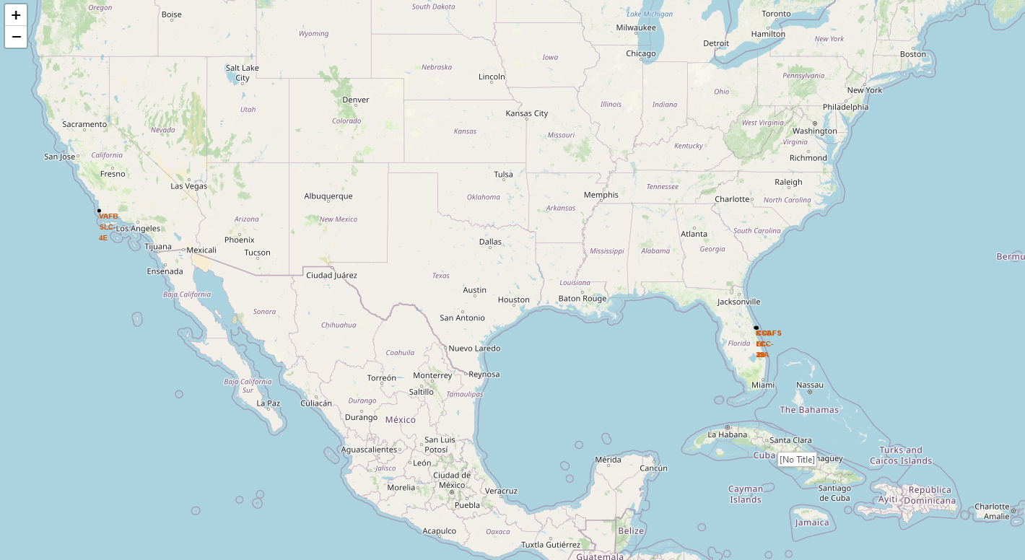
Folium Map Screenshot 1: Launch Sites on the map
All Launch sites are situated in two main locations:

Slide 36
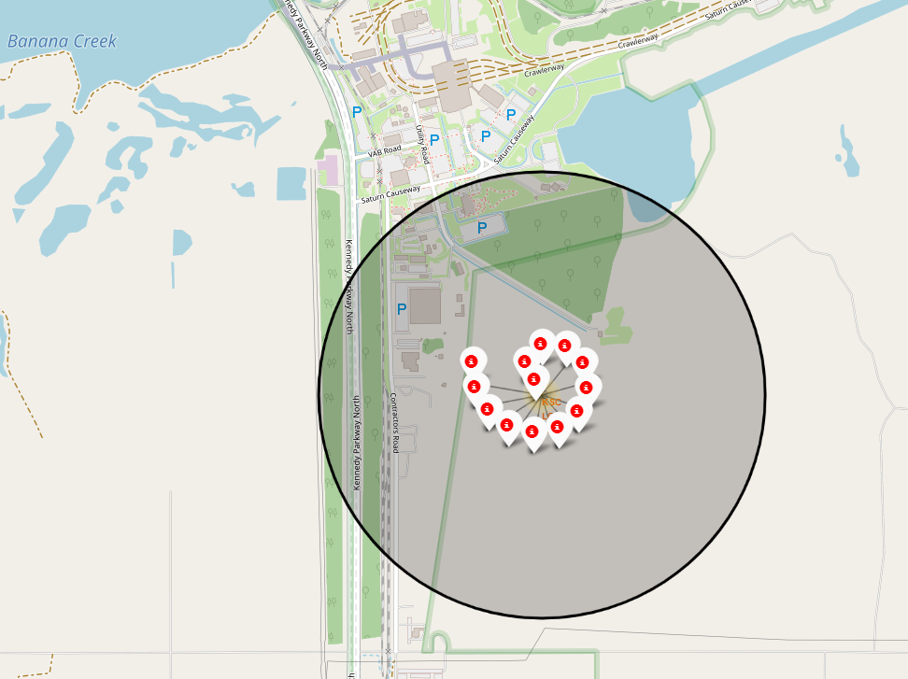
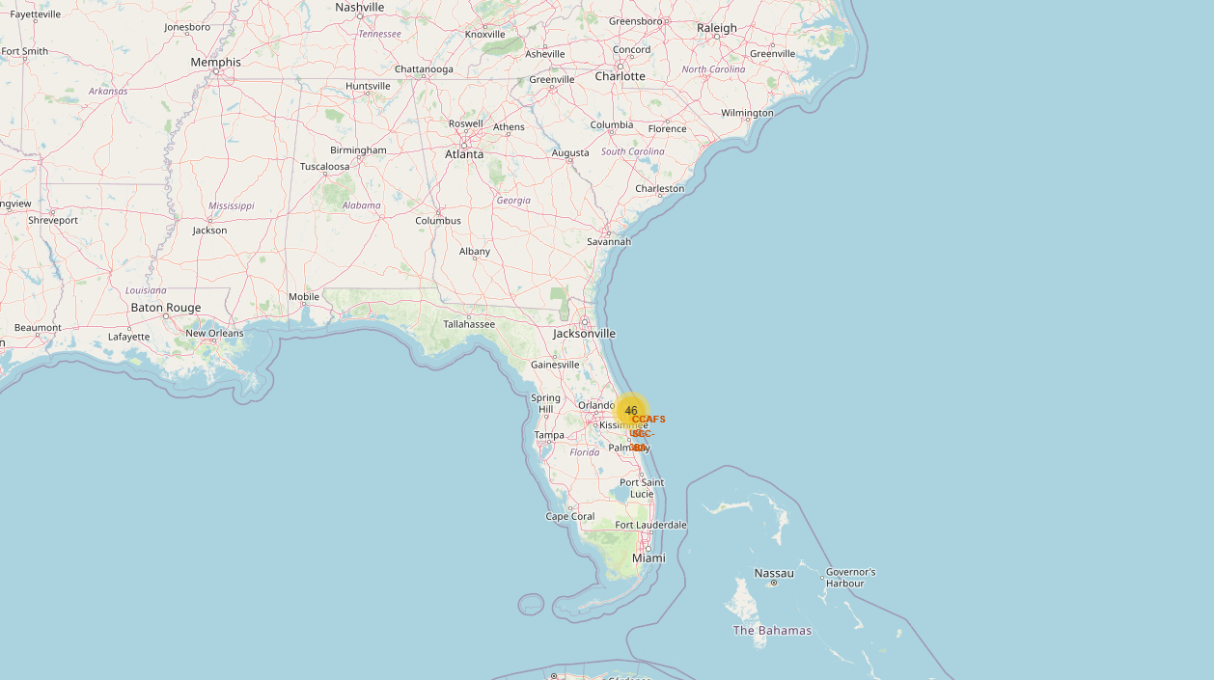
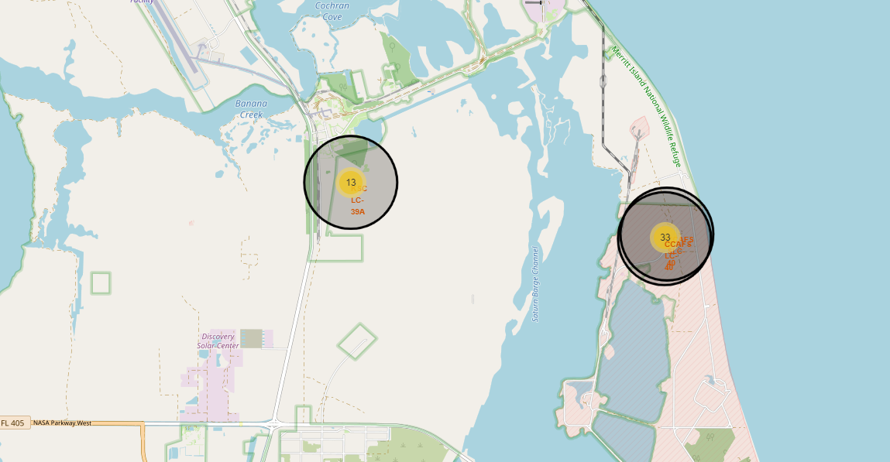
Folium Map Screenshot 2: success/failed launches for each site
Launch outcomes for each site are marked (red/green) to identify which sites have high success rates

Slide 37
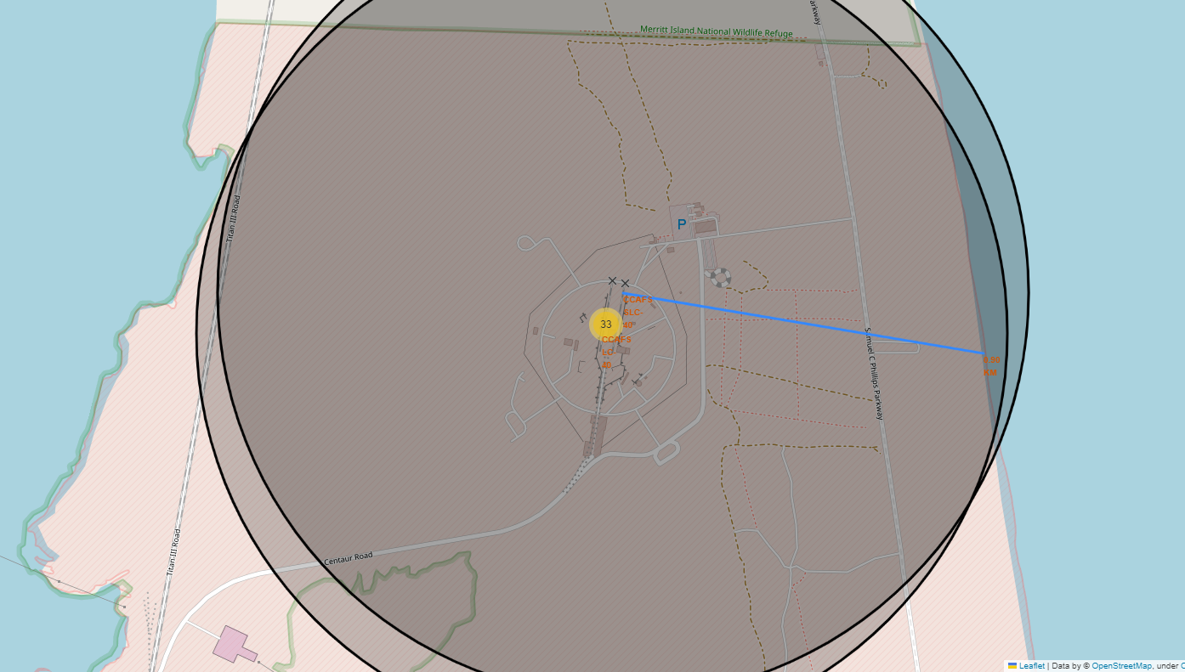
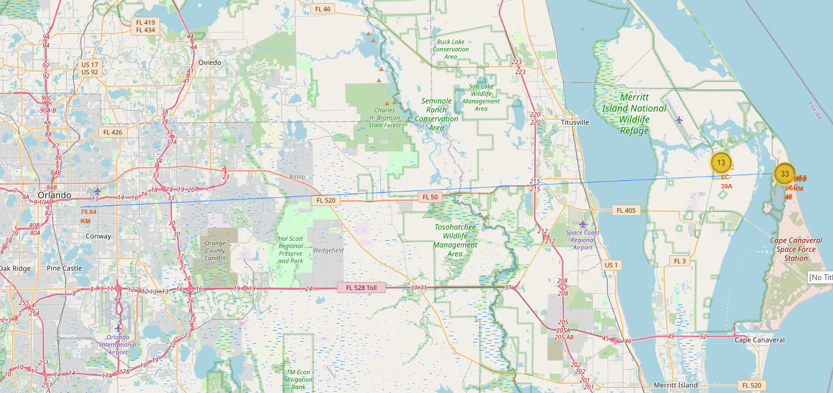
Folium Map Screenshot 3: distances between a launch site to its proximities
CCAFS LC-40 and CCAFS SLC-40 Launch sites are located 0.9 Km to the coastline and 75Km to a major city (Orlando)

Slide 38

Section 4

Slide 39
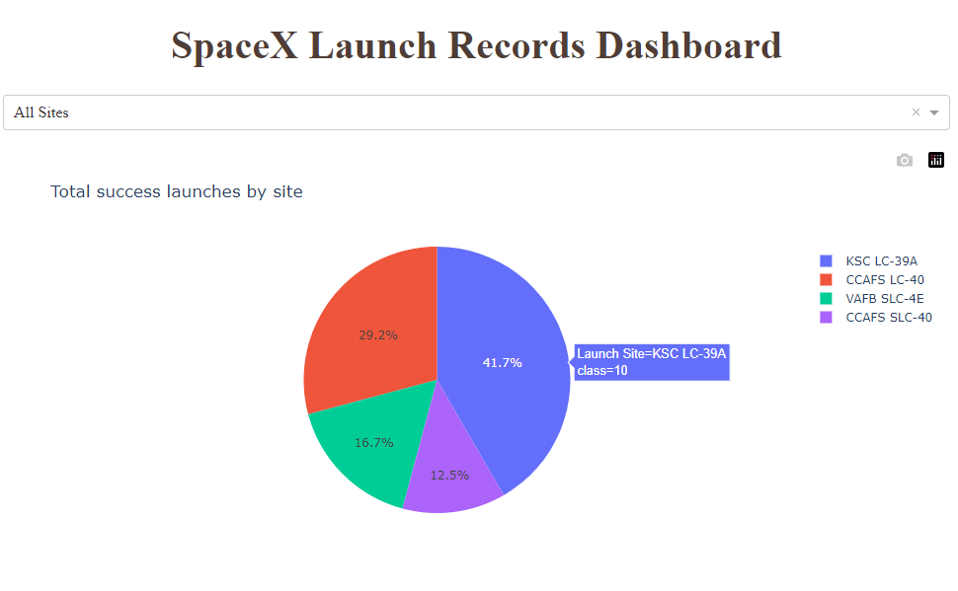
Dashboard Screenshot 1: launch success count for all sites
KSC LC-39A Launch Site has the highest count of success launches (41.7%)

Slide 40
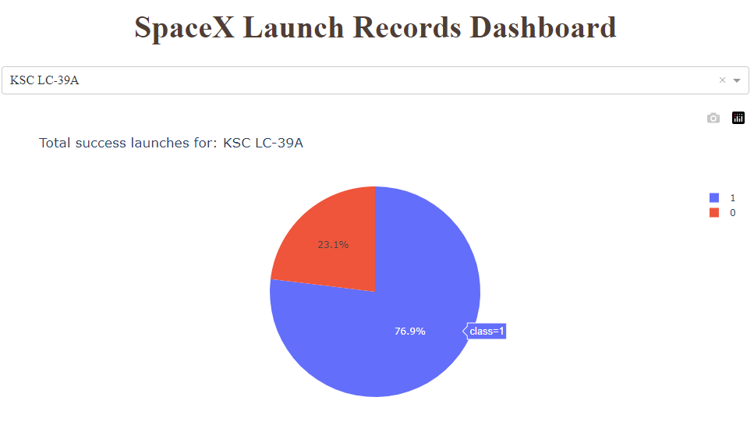
Dashboard Screenshot 2: launch site with highest launch success ratio
KSC LC-39A Launch Site has the highest launch success ratio (76.9%)

Slide 41
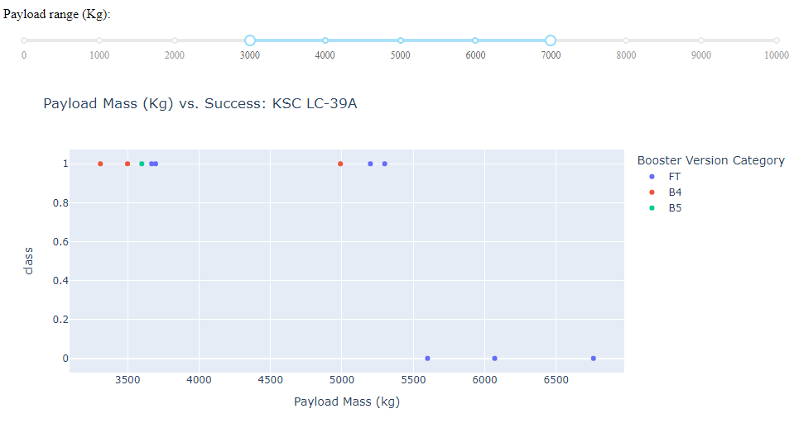
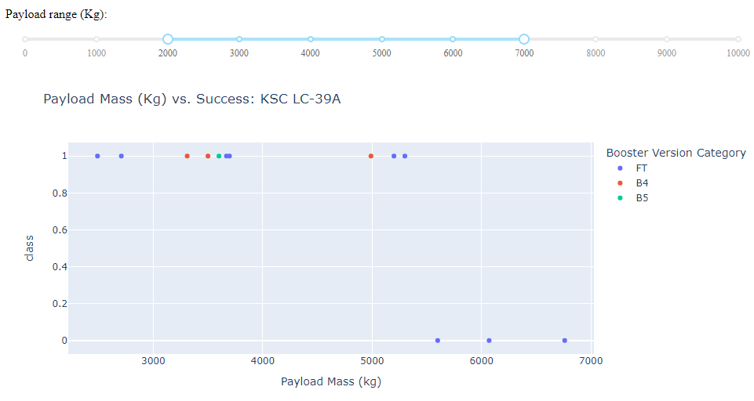

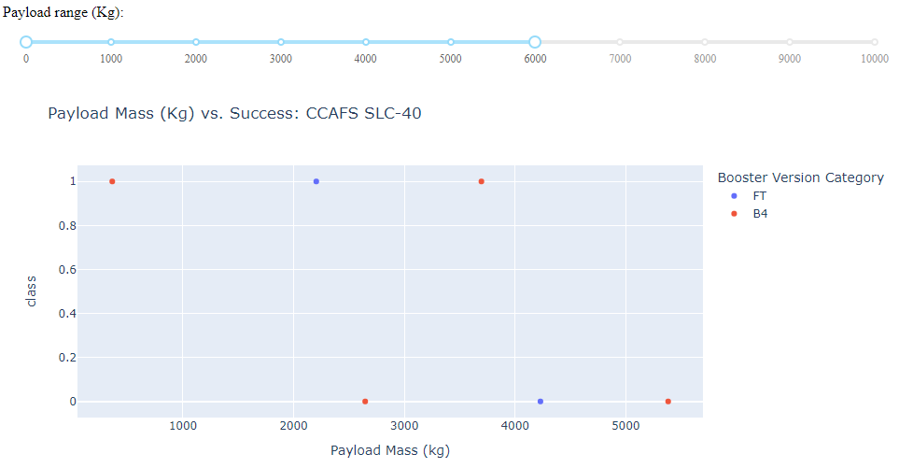
Dashboard Screenshot 3: Payload vs. Launch Outcome
KSC LC-39A Launch Site has the highest number of successful launches with 10 against 3 unsuccessful (all FT)

Slide 42

Section 5

Slide 43
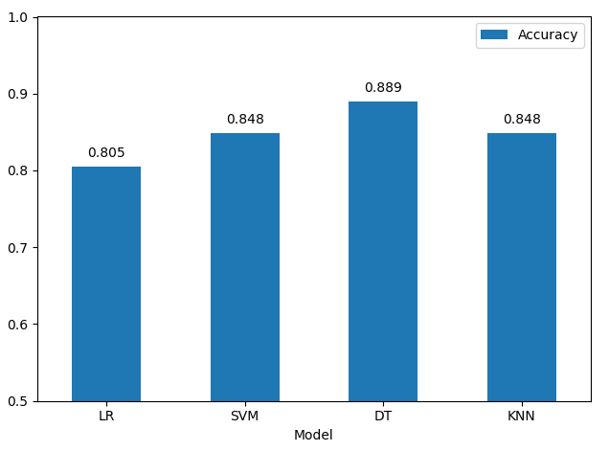
Classification Accuracy
The Decision Tree classifier has the highest accuracy of the models (test data set)

Slide 44
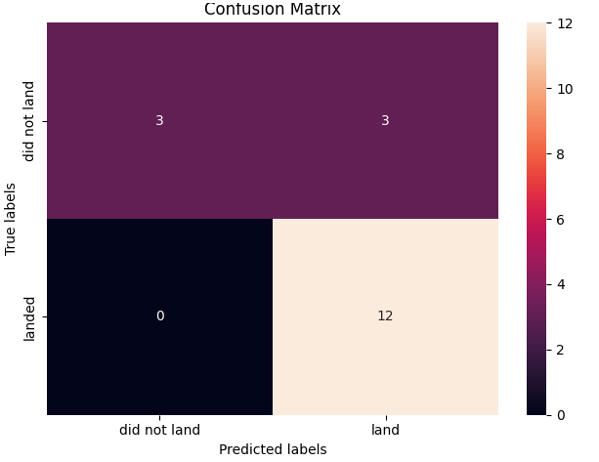
Confusion Matrix
This is the Confusion Matrix for the Decision Tree classifier:
From the 18 test samples (test dataset):
Out of 6 labelled as “did not land”
3 were classified as “did not land” (true negative)
3 were classified as “landed” (false negative)
Out of 12 labelled as “landed”
0 were classified as “did not land” (false positive)
12 were classified as “landed” (true positive)

Slide 45
Conclusions
Following are the key conclusions from this project
The Decision Tree classifier has the highest accuracy of the models with 88.9% on the test data
For the three launch sites, as Flight Number increases, the success rate also increases
Orbits with highest number of launches are GTO and ISS (27 and 21), with 52% and 62% success rates, respectively
KSC LC-39A Launch Site has the highest launch success ratio (76.9%)
The success rate on the launches has been increasing since 2013
All Launch sites are situated in two main locations
Launch sites are located close to the coastline

Slide 46
Appendix
All Jupiter Notebooks containing code, SQL queries, charts and data sets created during this project are available at Github following the link below
https://github.com/mjbaldomir/Capstone_IBMDS

Slide 47


